Slide 1


Novice Machine Learning E2E Project
Part 04
Stratifying the Data
Mukunthan Ragavan

Slide 2
E2E Machine Learning Project
Look at the Big picture.
Get the Data (Split the Data, Stratifying the Data).
Discover and visualize the data to get insights.
Prepare the data for ML algorithms.
Select a model to train it.
Fine-tune your model.
Present your solution.
Launch, monitor and maintain your system.

Slide 3
Stratifying the data! Why? Risk of introducing a significant Sampling bias. Solution as Stratified Sampling. Population is divided into homogeneous subgroups called strata, and the right number of instances is sampled from each stratum to guarantee that the test set is representative of the overall population.

Slide 4
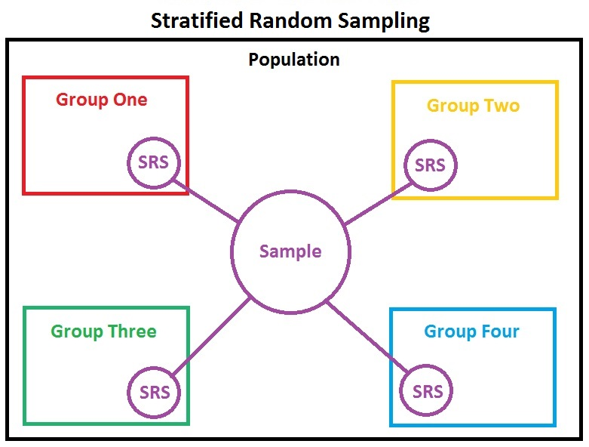
Stratifying example: When a survey company decides to call 1,000 people to ask them a few questions, they don’t just pick 1,000 people randomly in a phone book. They try to ensure that these 1,000 people are representative of the whole population. For example, the US population is composed of 51.3% female and 48.7% male, so a well-conducted survey in the US would try to maintain this ratio in the sample: 513 female and 487 male.

Slide 5
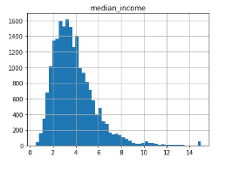
As discussed with Business……
Suppose you chatted with experts who told you that the median income is a very
important attribute to predict median housing prices. You may want to ensure that
the test set is representative of the various categories of incomes in the whole dataset.
Since the median income is a continuous numerical attribute, you first need to create
an income category attribute.

Slide 6
Coding in action !

Slide 7
Thanks All for watching and your subscription !

